Slide 1
Mining of Cryptocurrency
Group 07
MD. Shakil Ahmed 2013
Masud Rana 2015
MD. Akram Hossain 2016
MD. Monir Hossain 2018
Tajul Islam 2019
Ashfaqur Rahman Tokee 2022
Amit Azim Amit 2090

Slide 2

Cryptocurrency
Cryptocurrency is a form of payment that can be exchanged online for goods and services.
Cryptocurrencies work using a technology called blockchain. Blockchain is a decentralized technology spread across many computers that manages and records transactions.

Slide 3
What is Cryptocurrency Mining?
Cryptocurrency mining is the process of verifying and adding transaction records to a blockchain network. Miners compete to solve complex mathematical problems, and the first to solve the problem adds the next block to the blockchain network and is rewarded with a certain amount of cryptocurrency. This process helps to secure the network and confirm transactions. The main aim of cryptocurrency mining is to earn rewards in the form of the cryptocurrency being mined.
Cryptocurrency mining requires significant computational power and requires specialized hardware known as ASICs. The difficulty level of the mathematical problems solved by miners can vary, making it more or less profitable to mine different cryptocurrencies at different times. The process of cryptocurrency mining also consumes a large amount of energy and contributes to environmental concerns.

Slide 4
About Cryptocurrency Mining
Cryptocurrency Mining is done to fetch the units of cryptocurrency by solving complex mathematical calculations and problems. Cryptocurrency does not have a central controlling authority. So, there is a limited number of units of cryptocurrency.
Every unit has specific digital data and key and it can only be found after executing a huge number of calculations. The only feasible way to arrive at a hash matching the correct criteria is to simply calculate as many as possible and wait until you get a matching hash. When the right hash is found, a new block is formed and the miner that found it is awarded with units of cryptocurrency.

Slide 5
Why Is Mining Needed?
Ledger addition:
In cryptocurrency, a ledger is a database that records all transactions made on the network. The ledger is maintained and updated by a decentralized network of computers, called nodes, which follow a set of consensus rules to validate and add new transactions to the ledger. The process of adding new transactions to the ledger is called ledger addition. This process helps maintain the integrity and security of the cryptocurrency network, as each ledger addition is verified and approved by multiple nodes in the network. The ledger acts as a historical record of all transactions and provides a secure and transparent way of tracking and verifying the ownership of cryptocurrency assets.

Slide 6
Why Is Mining Needed?
Financial deterrent:
Financial deterrent in cryptocurrency refers to the measures that are implemented to prevent unauthorized or fraudulent transactions in the blockchain network. The main aim of these deterrents is to protect the network from malicious actors who might try to exploit it. This can include measures such as proof of work algorithms, cryptographic signatures, and consensus protocols. These deterrents ensure that only legitimate transactions are processed and verified in the blockchain, maintaining its integrity and stability. Financial deterrents play a crucial role in the security and stability of cryptocurrency networks and are critical for the successful functioning of cryptocurrencies

Slide 7
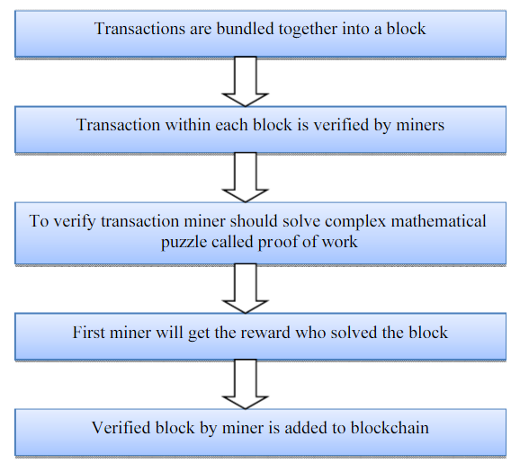
Validating cryptocurrency mining
All cryptocurrency mining solutions require “Proof of Work(PoW)” to establish a new bitcoin blockchain
Proof of Work is consensus algorithm consist of complex cryptographic mathematical algorithm. The value of nonce is hashed with SHA-256 and it will generate hash including number of zeros which is included in particular block in the chain. This high-level mathematical computation calculated by miners using high computing hardware. Bitcoin miners utilize the SHA-256 hashing calculation and determine the hash worth to deliver the hash. On the off chance that it is not exactly the given condition (the objective), at that point it is expected that the puzzle is tackled.
Flow of PoW

Slide 8
Solo Mining
Solo mining is a process of cryptocurrency mining where a miner runs the mining software on their own computer, without joining a mining pool.
The miner attempts to solve the complex mathematical problem required to validate transactions on the blockchain network and, in return, is rewarded with newly mined cryptocurrency.
The advantage of solo mining is that if a miner successfully solves a block, they receive the entire block reward, as opposed to sharing the reward with other miners in a pool. However, solo mining can be less profitable and less efficient compared to pool mining, as the chances of successfully solving a block are much lower for an individual miner compared to a large pool of miners.
Additionally, the high computational power required for cryptocurrency mining can result in a higher electricity bill for the miner, making solo mining a costlier option.

Slide 9
Pooled Mining
Pool mining is a method of cryptocurrency mining where a group of miners come together to pool their computational power to increase their chances of solving a block and earning the block reward. The process works as follows:
Miners join a mining pool: Miners can choose to join a mining pool that suits their needs. There are many different types of mining pools, each with its own fees, payment methods, and rules.
Pooled computational power: Each miner in the pool contributes their computational power to the pool. This combined computational power makes it more likely that the pool will solve a block.
Block reward distribution: When a block is solved, the block reward is divided among all the miners in the pool based on the amount of computational power they contributed. This is usually calculated as a proportion of the hash rate each miner contributed to the pool.
Regular payments: Miners in a pool receive regular payments for their contribution to the pool. The frequency of these payments depends on the pool and the cryptocurrency being mined.

Slide 10
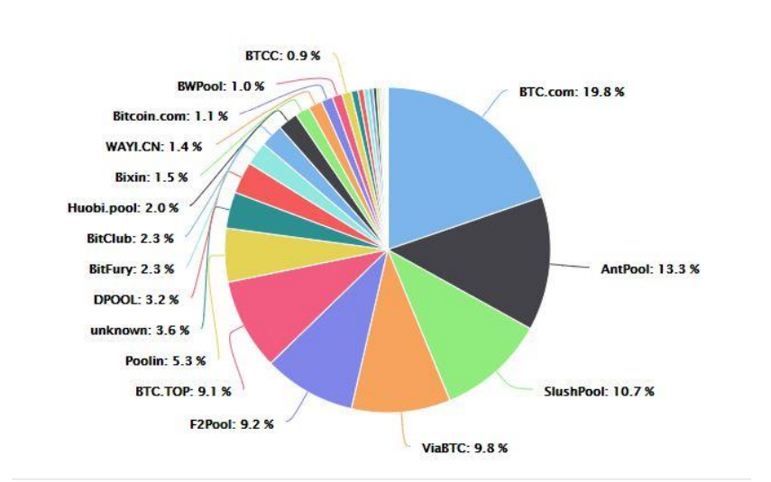
Pooled Mining
Pool mining has several benefits compared to solo mining. Firstly, the chances of successfully solving a block are higher, as the pool has a larger combined computational power. Secondly, pool mining is more predictable, as miners receive regular payments for their contributions. Finally, pool mining can be more profitable for small miners, who might not have the computational power to successfully mine blocks on their own.
Bitcoin mining pools across the glove

Slide 11
What You Need to Mine Cryptocurrency
There are generally three basic components to a mining operation: the wallet, the mining software, and the mining hardware.
Cryptocurrency Wallet: You'll need a wallet for your cryptocurrency to store the keys for any tokens or coins your mining efforts yield. Wallets have a unique address allowing you to send and receive tokens securely. There are many types of online wallets, and there are even "cold storage" wallets that don't operate online. Decide which one is best for your needs before you start mining.
Mining Software: Most mining software is free to download and use and is also available for various operating systems. For popular cryptocurrencies like Bitcoin, you'll find that multiple types of software can be used. While many of these options will be effective, slight differences could impact your mining operation.
Mining Hardware: Mining hardware may be the most expensive component of a mining rig setup. You'll need a powerful computer, perhaps even one specifically designed for mining.

Slide 12
Mining Hardware and Software
Hardware:
Antminer S19 Pro
Antminer T9+ Pionex Recommended Crypto Exchange
AvalonMiner A1166 Pro
AvalonMiner 1246
WhatsMiner M30S++
WhatsMiner M32-62T
Software
Bitcoin Miner
BTCMiner
CGMiner
BFGMiner
EasyMiner

Slide 13
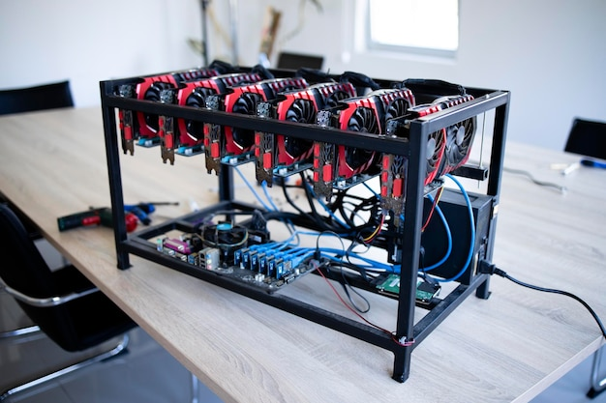
Mining Setup
The resources required for mining Bitcoin include:
At least one specialized computer (called an Application-specific Integrated Circuit or ASIC miner), which is specifically designed to compete for and support a particular cryptocurrency.
A reliable and inexpensive energy supply.
A dependable internet connection.
A cooling infrastructure (whether you’re mining at home or on a Bitcoin farm).
A computer, software, and the technical skill to establish and monitor operations.
Cryptocurrency Mining rig

Slide 14
Cryptocurrency Mining Process
Here is a general outline of the cryptocurrency mining process:
Solving complex mathematical problems: The first step in the cryptocurrency mining process is to solve complex mathematical problems, also known as proof-of-work (PoW). Miners compete against each other to solve these problems, and the first miner to solve the problem adds a new block to the blockchain.
Verifying transactions: The miner then verifies all transactions in the block. Transactions are grouped into a block and verified by the miner. The transactions must meet certain criteria, such as validating that the sender has enough funds to complete the transaction.

Slide 15
Cryptocurrency Mining Process
Creating a block header: The miner then creates a block header, which includes a reference to the previous block in the blockchain and the solution to the mathematical problem solved in step 1.
Broadcasting the block: The miner broadcasts the block to the network, and the network verifies the block to ensure that it meets the criteria to be added to the blockchain. If the block is verified, it is added to the blockchain, and the miner is rewarded with a certain number of cryptocurrency coins.
Continuing the process: The process repeats continuously, with miners verifying new transactions and adding new blocks to the blockchain.

Slide 16
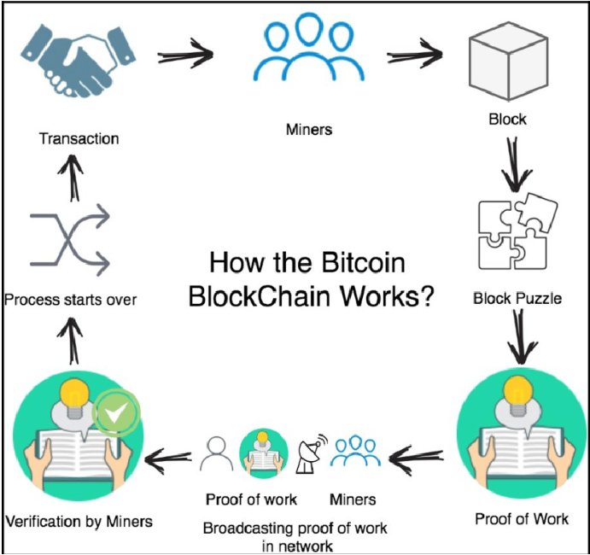
Bitcoin Mining Steps
The calculation for bitcoin mining comprises of the following steps:
A header of the past block is recovered from the Bitcoin network.
Assemble a progression of organization exchanges into a block to be proposed. T. Pawar et al. / A Survey on Mining Cryptocurrencies332
Using the SHA-256 calculation, process the twofold hash of the past block's header joined with a nonce and the recently recommended block.

Slide 17
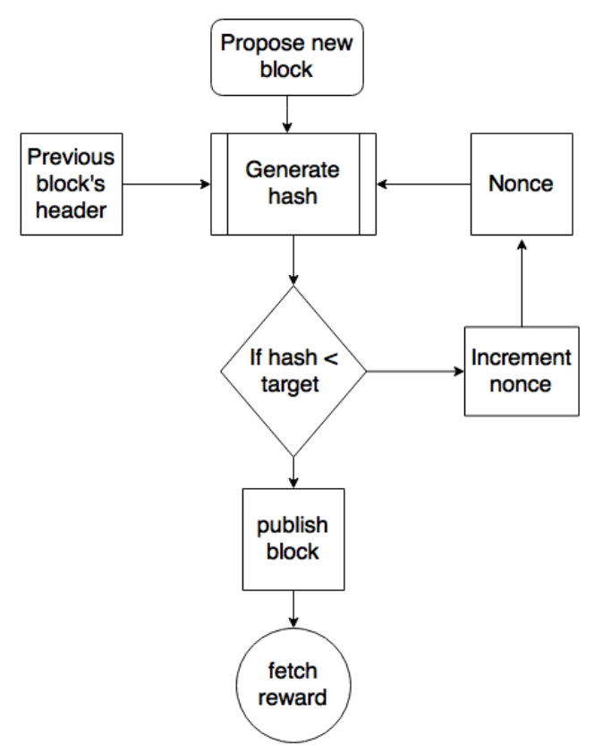
Bitcoin Mining Steps
Check that the subsequent hash is lower than the current (target) level of trouble; at that point, PoW is addressed. Because of the fruitful PoW, the block found is communicated to the organization and the award is gotten by excavators.
If the subsequent hash isn't not exactly the current degree of trouble (target), rehash the interaction in the wake of expanding the occasions.
Flowchart of mining

Slide 18
Types Of Bitcoin Mining
Bitcoin mining can be done in several ways and forms, each delivering different levels of hashing power and block rewards. Here are the various ways that one can mine Bitcoin:
CPU Mining: When Bitcoin was launched in 2009 and was mined for the first time, it got mined via central processing units (CPUs), which is also known as the brain of a computer, containing all the circuitry required to process input and output results.
GPU Mining: GPUs based systems, which are mainly used for gaming, modern video editing, proved to be more efficient for mining with better hash rate than CPUs. The first software for GPU mining was launched in 2010. However, the GPU mining of Bitcoin was fairly short lived and got replaced by a new kind of hardware- ASIC by 2015.

Slide 19
Types Of Bitcoin Mining
ASIC Mining: ASIC is a short for application-specific integrated circuit is a kind of hardware which is designed for mining cryptocurrencies only. It was launched in 2012, and proved to be 200 times more powerful than basic GPU miners. However, ASIC mining rigs are very expensive, with prices ranging from $2,000 to $15,000.
FPGA Mining: FPGA stands for field-programmable gate array (FPGA), which is a better choice between GPU miners and ASIC miners in terms of speed and cost efficiency. FPGAs are also able to stabilize vigorous hashing power as they are not meant to be locked into mining a specific coin or algorithm like ASIC miners.

Slide 20
Types Of Bitcoin Mining
Cloud Mining: This is a latest way of mining Bitcoins, where the miner can buy a cloud mining service or purchase a contract from a cloud mining provider who is specialized in cryptocurrency mining rigs. This facilitates the miner to mine Bitcoins without bearing the sunk costs and maintenance requirements of mining hardware set up. But one is required to be very cautious in order to choose a reputed cloud miner to avoid any kind of scams or frauds.

Slide 21
Energy Consumption and Environmental Impact
Cryptocurrency mining is an energy-intensive process that requires a large amount of computing power. This power is generated from electricity, which has led to significant energy consumption and a significant impact on the environment.
The energy consumption of cryptocurrency mining is estimated to be equivalent to that of entire countries, and it is rapidly increasing. The energy used in the process is mostly derived from non-renewable sources such as coal, natural gas, and oil. This leads to increased greenhouse gas emissions, which contribute to global warming and climate change.
Moreover, the process of cryptocurrency mining also consumes a large amount of water and produces a significant amount of waste, further exacerbating its environmental impact. To mitigate the negative impact of cryptocurrency mining on the environment, it is essential to promote the use of renewable energy sources, develop sustainable mining practices, and improve the efficiency of mining equipment.

Slide 22
Profitability of Mining
The profitability of mining cryptocurrency depends on several factors, including the cost of electricity, the difficulty of mining, the price of the cryptocurrency being mined, and the efficiency of the mining hardware.
The competition in the mining market is increasing as more miners enter the market, driving up the difficulty of mining and reducing profitability. Some miners have responded by developing more efficient hardware, while others have shifted their focus to less competitive cryptocurrencies.
The profitability of mining is a key factor that determines the sustainability of the mining industry and the long-term viability of cryptocurrencies as a whole.

Slide 23
Risks of Cryptocurrency Mining
Market Volatility: The value of cryptocurrencies can be highly volatile, and changes in value can greatly impact the profitability of mining.
Technical Risks: Technical issues, such as hardware failures, network disruptions, and software bugs, can result in reduced efficiency and profitability for miners.
Energy Costs: Cryptocurrency mining is energy-intensive, and the cost of electricity can greatly impact the overall profitability of mining.
Difficulty Increases: Over time, the difficulty of mining increases, which can result in reduced profitability as more computing power is required to mine new blocks.

Slide 24
Risks of Cryptocurrency Mining
Competition: The number of miners in the market continues to increase, which can result in increased competition and reduced profits for individual miners.
Regulatory Risks: Governments and regulatory bodies may introduce regulations that impact the profitability and legality of cryptocurrency mining, or even ban it outright in some cases.
Security Risks: Cryptocurrency mining can be vulnerable to cyberattacks and hacking, which can result in the loss of digital assets and equipment.

Slide 25
Potential Advancement and Future of Mining
Cryptocurrency mining is a rapidly evolving field that is expected to see significant advancements in the future. One potential area of improvement is in the efficiency and energy consumption of mining hardware. Currently, the energy consumption of cryptocurrency mining is a major concern, as it contributes to carbon emissions and environmental degradation.
In order to address this issue, research is being conducted into alternative methods of mining that use less energy, such as proof-of-stake algorithms and other consensus mechanisms. Additionally, advances in hardware technology, such as ASICs and GPUs, are expected to continue to improve the efficiency of mining, potentially making it more profitable for individuals and companies.

Slide 26
Potential Advancement and Future of Mining
Another area of potential advancement is in the development of decentralized systems for managing the mining process. This could allow for a more distributed and secure network, as well as a more equitable distribution of rewards to miners.
Overall, the future of cryptocurrency mining is expected to be shaped by advances in technology, energy efficiency, and decentralization. As the field continues to evolve, it is likely that new opportunities will emerge for individuals and companies to participate in and benefit from the growth of the cryptocurrency industry.

Slide 27
Thank You

